Slide 1
SMART PUBLIC RESTROOM
IOT_PHASE 4 PROJECT

Slide 2
Context:
Introduction
Software required
Components required
Program
Output
Advantages

Slide 3
INTRODUCTION
Smart washrooms are among recent IoT solutions that are very soon to be implemented here and there. Such new generation restrooms are expected to significantly improve customer experience and employee well-being while also lower costs allocated to maintain equipment.
Here in addition with development part 2 we are going to add automatic flush to maintain the hygienic surroundings with the help of temperature sensor.

Slide 4
Software required
Wokwi software

Slide 5
Components
Ardunio uno
Breadboard
LED
Push button
DS18B20
Resistor
Servo

Slide 6
Program:Occupancy indicater
#include <Servo.h>
const int buttonPin = 4;
const int ledPin = 12;
const int servoPin = 9; // Digital pin for the servo
int buttonState = 1;
Servo doorServo;
void setup() {
pinMode(ledPin, OUTPUT);
pinMode(buttonPin, INPUT);
doorServo.attach(servoPin);//Attaching the servo to the pin
}
void loop() {
buttonState = digitalRead(buttonPin);
if (buttonState == HIGH) {
// Restroom is occupied
digitalWrite(ledPin, HIGH);

Slide 7
// Open the door (rotate the servo)
doorServo.write(90); // Angle to open the door
} else {
// Restroom is vacant
digitalWrite(ledPin, LOW);
// Close the door (return the servo to its initial position)
doorServo.write(0); // Angle to close the door
}
}
Output Link:
https://wokwi.com/projects/378898578284772353

Slide 8
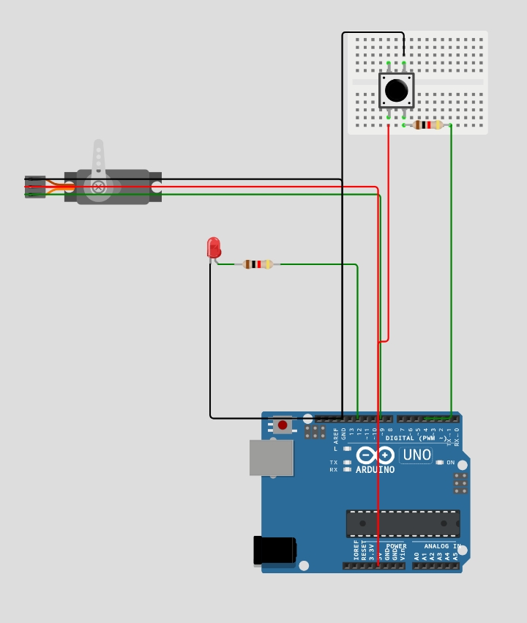
Output:

Slide 9
Program:Temperature sensor
const int DS18B20_pin = A1; /* DS18B20 O/P pin */
void setup() {
Serial.begin(9600);
}
void loop() {
int temp_adc_val;
float temp_val;
temp_adc_val = analogRead(DS18B20_pin); /* Read Temperature */
temp_val = (temp_adc_val * 4.88); /* Convert adc value to equivalent voltage */
temp_val = (temp_val/10); /* DS18B20 gives output of 10mv/°C */
Serial.print("Temperature = ");
Serial.print(temp_val);
Serial.print(" Degree Celsius\n");
delay(1000);
}
Output link: https://wokwi.com/projects/379628162270992385

Slide 10
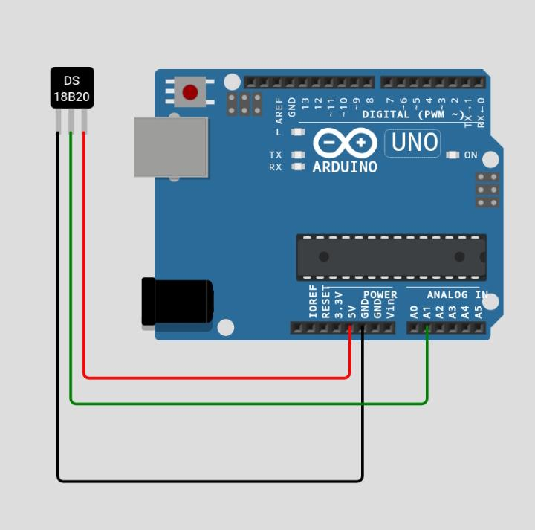
Output:

Slide 11
Program:Automatic Flush
#include <Servo.h>
Servo servo1;
int sensor=0;
int sensorPin=5; //distance sensor on analog pin 5
int PreparingToFlush=0;
void setup() {
Serial.begin(9600);
servo1.attach(10); //servo data line on pin 10
servo1.write(3);
}
void loop() {
sensor=analogRead(sensorPin);
if (sensor > 100){ //if distance sensor detects someone
delay(2000); // wait
sensor=analogRead(sensorPin);

Slide 12
if (sensor > 100){ // check again to make sure someone is actually there
PreparingToFlush=1;
}
}
if (PreparingToFlush==1){ //if a person has been detected
if (sensor < 100){ // if the person has now left
servo1.write(175); //FLUSH
delay(5000);
servo1.write(3);
delay(1000);
PreparingToFlush=0; //reset the trigger
}
}
delay(10);
}
Output link:https://wokwi.com/projects/379630700498494465

Slide 13
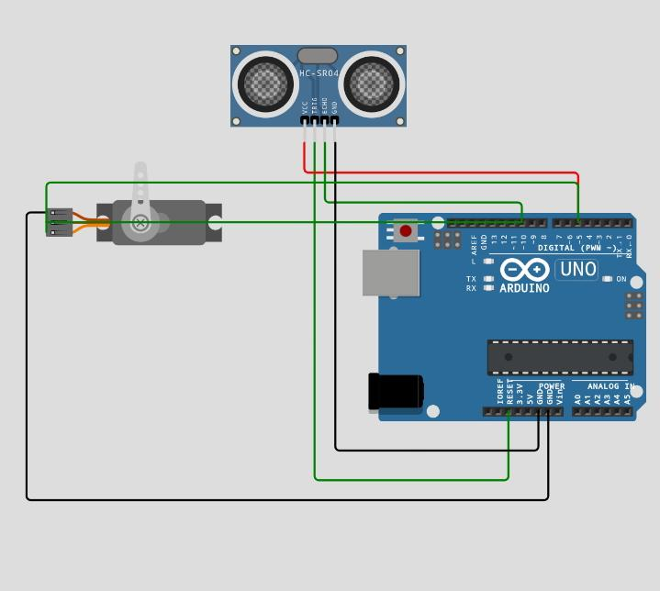
Output:

Slide 14
Advantages:
Improvement of hand hygiene: each is encouraged to wash hands when leaving the washroom.
Hand disinfection by sanitizer usage in hospitals to track hand hygiene compliance to help prevent hospital-acquired infections.
Anonymity: separate individuals are not tracked, the system only counts the number of people entering and washing hands.
Availability of statistics on the number of employees who skip hand washing when leaving a restroom, which is crucial for any business, healthcare organization, and food industry.

Slide 15

THANK YOU
By team:
A.Anbuselvi
D.Arthi
S.Abirami
C.Aarthi
R.Abirami

